Slide 1

Web technologies using java
Course 10 – spring data jpa

Slide 2
agenda
JPA entity lifecycle
Spring data jpa
Transaction management
Spring data jpa Transaction management

Slide 3
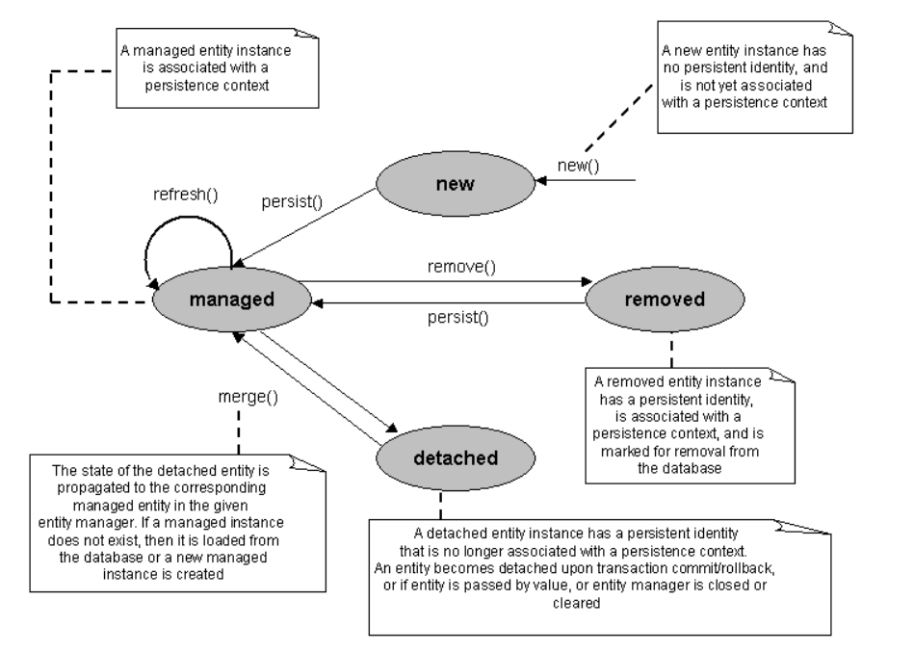
Jpa entity lifecycle

Slide 4
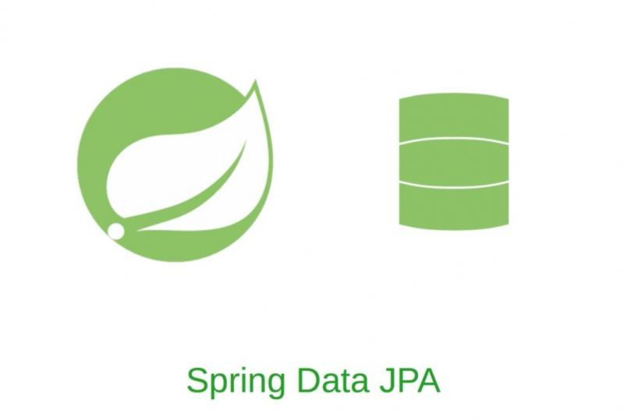
Spring data jpa
Spring Data significantly reduces the amount of boilerplate code required to implement data access layers for various persistence stores.
Spring Data JPA is a JPA Data Access Abstraction.
Spring Data JPA is not a JPA provider. It is a library/framework that adds an extra layer of abstraction on the top of a JPA provider (like Hibernate, Eclipse Link or any other JPA provider.).

Slide 5
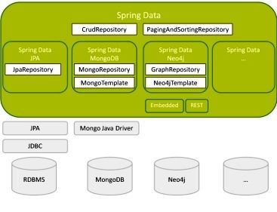
Spring data jpa

Slide 6
Spring data jpa
Queries built based on repository method names
@Query with JPQL(Java Persistence Query Language)
@Query(native = true)
@Modifying

Slide 7
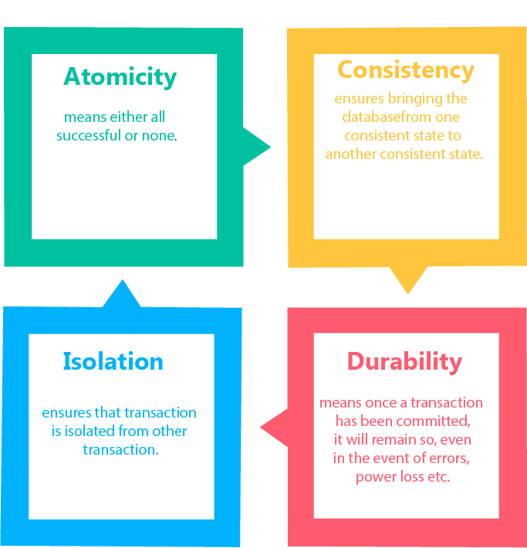
Transaction management
transaction management aims to prevent data inconsistent state
a transaction is a single logical unit of work that accesses and possibly modifies the contents of a database
transaction properties are used for maintaining the integrity of database during transaction processing:
Atomicity
Consistency
Isolation
Durability

Slide 8
Spring data jpa transaction management
@Transactional can be put on class or method level
@Transactional attributes:
propagation: specifies how the transaction propagates. We can continue an existing transaction, if one exists, or create a new transaction. The default is Propagation.REQUIRED
readOnly: specifies if the transaction is read-only
noRollbackForClassName: specifies which exceptions should not cause a rollback of a transaction
rollbackForClassName: specifies which exceptions should cause a rollback of a transaction
timeout: specifies how long should we wait for a transaction to complete
isolation: specifies the isolation level for the transaction. The default is Isolation.DEFAULT
transactionManager: identifies the transaction manager that manages this transaction

Slide 9
Spring data jpa transaction management
Spring Boot auto-configures a transaction manager based on the libraries in the classpath
transaction managers for relational databases:
DataSourceTransactionManager: can manage transactions for one JDBC database resource
JpaTransactionManager: can manage transactions for one JPA database resource

Slide 10
bibliography
Spring in Action, by Craig Walls
Spring REST, by Balaji Varanasi, Sudha Belida
Pro JPA 2, Mike Keith, Merrick Schincariol
https://docs.spring.io/spring-data/jpa/docs/current/reference/html/#repositories
https://docs.spring.io/spring-data/jpa/docs/current/reference/html/#repository-query-keywords
https://docs.oracle.com/javaee/6/tutorial/doc/bnbtg.html

Slide 11

Q&A

Slide 12
THANK YOU
DANIELA CIUPERCA

